Slide 1
Experiential Learning Phase - I :
Operating Systems
CS235AI
Distributed Shared Memory
ARYA HARIHARAN (1RV22CS029)
PROFESSOR – Dr. PAVITHRA H

Slide 2
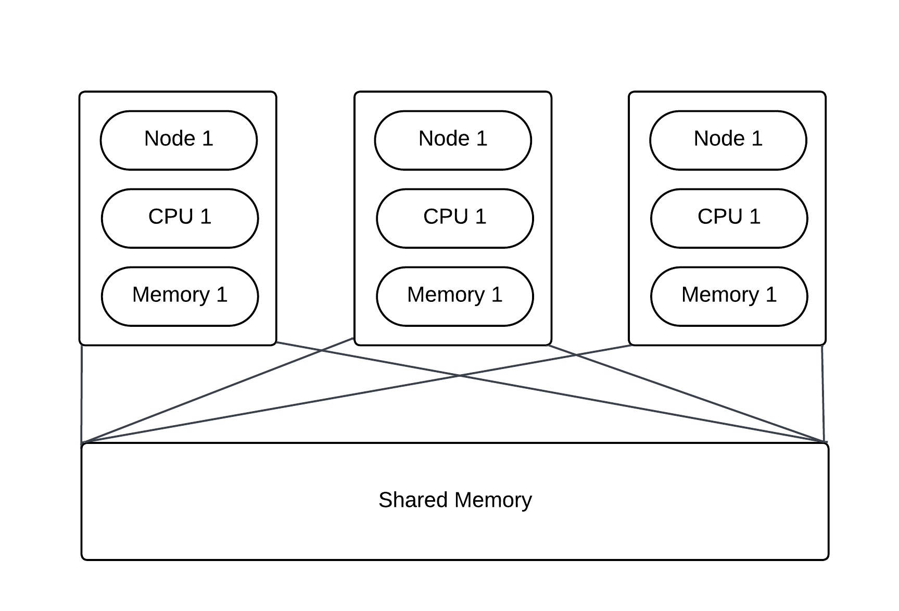
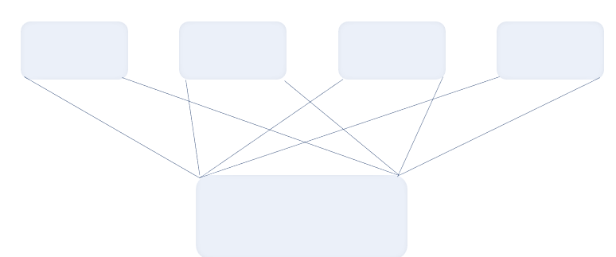
INTRODUCTION

Slide 3
A cluster of computers are present, each with its own physical memory.
Through DSM, each computer/node can also access a shared memory space.
It creates the illusion of a single, coherent memory space across the network, allowing access to shared data as if it were local.
Distributed shared memory is a service that manages memory across multiple nodes so that applications will have the illusion that they are running on a single shared-memory machine.

Slide 4
PROBLEM STATEMENT
To simulate Distributed Shared Memory (DSM) architecture for a two process system as a proof of concept for an n-process system using multiprocessing

Slide 5
OBJECTIVES
Allocate shared memory space for a two process system
Create a page server to listen for and serve incoming page requests
Implement a page fault handler when requests arise for pages on remote machines
Utilise the migration algorithm to implement the system
Demonstrate, at least, the transfer of one page in the memory space

Slide 6
RELEVANCE TO COURSE
This project involves several concepts that are core OS concepts or are deeply interconnected to OS –
Node simulation using processes
Shared memory management through pages and page fault handlers
Use of mutex locks and other synchronisation tools for page transfer

Slide 7
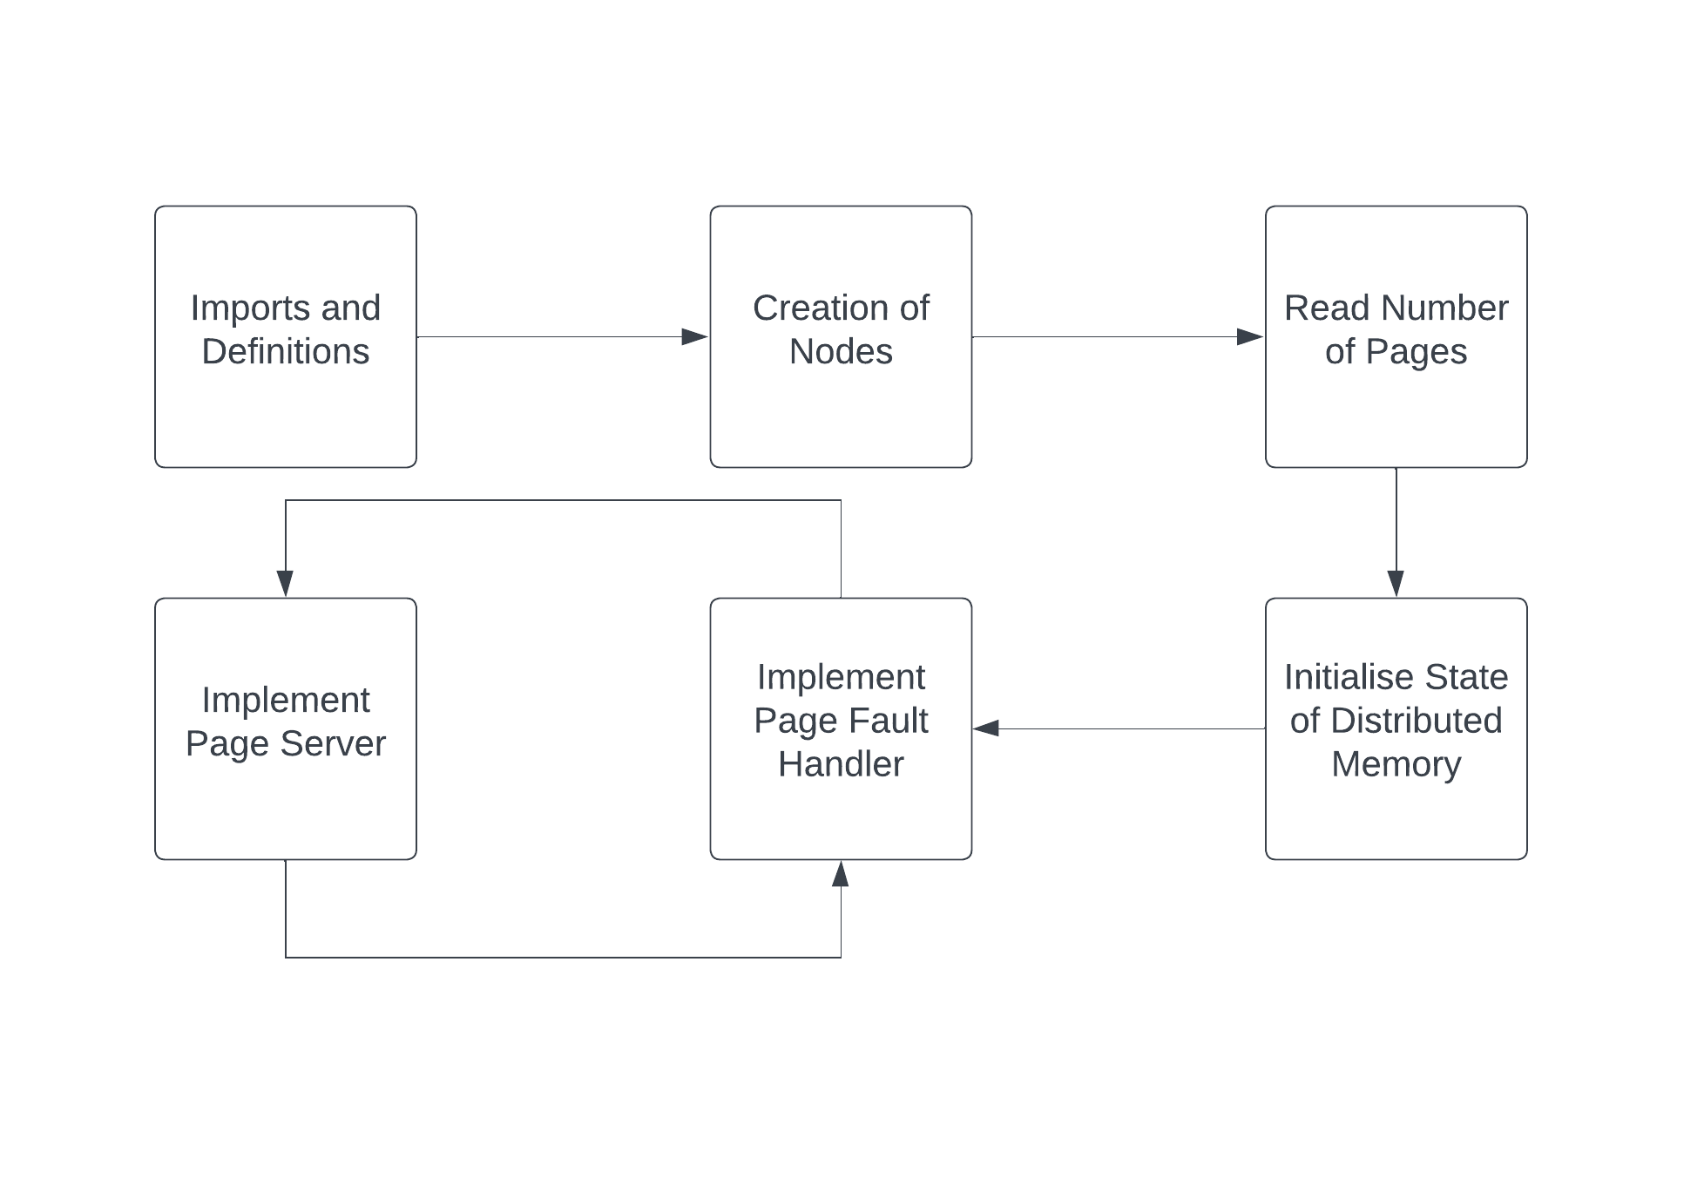
METHODOLOGY

Slide 8
METHODOLOGY
1
2
Definition and global variables
Define the page size by either sysconf() or any other fixed value.
Set the base address of shared virtual memory space.
Create a per page mutex for page fault handling.
Create Nodes
Simulate the nodes of the network by creating two asynchronous process using fork(), referred to as the master and slave process.
Initialize initial state of the distributed shared memory
Use mmap to create shared memory for master and slave.
Initially, the slave owns the first half of the shared memory space and the master owns the second half.
Initialize per page mutexes.
Create a server thread to process page requests.
3
4
Read Number of Pages
The user will be asked to enter the number of pages that are required for both the master and slave processes.

Slide 9
METHODOLOGY
5
Implement page fault handler
When a process tries to write to a memory location not present locally, a page fault occurs.
Page fault handler invokes the page server.
Implement a per page mutex.
Copies the page into local memory.
Set the access to write from read-only.
Unlocks the mutex.
Implement page server
Identifies the page number of the incoming request and the process which has control over it.
Implements a per page mutex.
Sets the page as protected with only read functionality for current-holding process.
Sends a copy of the page to the requesting process.
Current process is made to relinquish control over the page.
Mutex lock is unlocked
6

Slide 10
TOOLS/API
Some of the tools and APIs that will be used in this project are -
C programming and Linux
fork() system call
Pthread API
mmap() system calls

Slide 11
WHY DSM?
1
2
Simplified Parallel Programming
Utilization of Cluster Resources
A DSM system allows extending these familiar models (like pthreads and OpenMP) to a distributed environment, simplifying the transition to distributed computing.
Clusters of machines offer a cost-effective way to increase computing power and resources.
3
4
Resource Efficiency
Load Balancing and Scalability
DSM systems can help in efficient resource utilization.
A DSM system can intelligently distribute memory pages across machines, achieving load balancing and improving scalability.

Slide 12
APPLICATIONS
Computationally Intensive Tasks
A scientific research project requires running computationally intensive simulations or numerical computations.
These simulations often involve complex mathematical models and require significant computational resources to execute.
Computational workload can be distributed across multiple nodes or clusters.
To coordinate data access and sharing of intermediate results between distributed nodes, DSM can be employed.

Slide 13
APPLICATIONS
Computationally Intensive Tasks
Lighting and illumination effects in virtual environments
Simulating the propagation of light rays through a scene, accounting for factors such as reflection, refraction, and scattering
Typically involves ray tracing or radiosity methods
DSM can aid in distributing the computational workload across multiple nodes
Distribution and sharing of scene data using DSM

Slide 14
REFERENCES
Nelson J, Holt B, Myers B, Briggs P, Ceze L, Kahan S, Oskin M. {Latency-Tolerant} software distributed shared memory. In2015 USENIX Annual Technical Conference (USENIX ATC 15) 2015 (pp. 291-305).
El-Ghazawi, Tarek, William Carlson, Thomas Sterling, and Katherine Yelick. UPC: distributed shared memory programming. John Wiley & Sons, 2005.
Wu J. Distributed system design. CRC press; 2017 Dec 14.
B. Nitzberg and V. Lo, "Distributed shared memory: a survey of issues and algorithms," in Computer, vol. 24, no. 8, pp. 52-60, Aug. 1991, doi: 10.1109/2.84877.
M. Stumm and S. Zhou, "Algorithms Implementing Distributed Shared Memory", Computer, vol. 23, no. 5, pp. 54-64, May 1990.

